Slide 1
Applied Machine Learning SEZG568/SSZG568
Dr Y V K RAVI KUMAR
yvk.ravikumar@pilani.bits-pilani.ac.in

Slide 2
Session 11(21st October,2023)

Slide 3
Session 10 – 14th October,2023
10 | Classification Models II: Ensembles techniques. Bagging, boosting, Random Forest | T1: Chapter 7 T2: Chapter 5
11 | Unsupervised Machine Learning: Dimensionality reduction and feature extraction, K-means clustering, EM algorithm | T1: Chapter 8-9 T2: Chapter 8

Slide 4
When does Ensemble work?
Ensemble classifier performs better than the base classifiers when error is smaller than 0.5
Necessary conditions for an ensemble classifier to perform better than a single classifier
Base classifiers should be independent of each other
Base classifiers should do better than a classifier that performs random guessing
Ensemble Methods work best with unstable base classifiers
Classifiers that are sensitive to minor perturbations in training set, due to high model complexity
Examples: Unpruned decision trees, ANNs, …
Low Bias in finding optimal decision boundary
High Variance for minor changes in training set or model selection procedure

Slide 5
Methods for Constructing an Ensemble Classifier
By manipulating the training set.
By manipulating the input features.
By manipulating the learning algorithm.

Slide 6
By manipulating the training set.
Multiple training sets created by resampling original data
Resample according to some sampling distribution
Example: equal probability
Example: weighted
Determines how likely it is that an example will be selected for training.
Classifier built from each training set.
Ensemble methods that manipulate the training set:
Bagging
Boosting

Slide 7
By manipulating the input features.
Subset of input features is chosen at random from overall collection of features
Each training set has different feature set
Ensemble method that manipulates input features:
Random Forest
Works well with datasets that contain highly redundant features

Slide 8
By manipulating the learning algorithm
… so that applying algorithm on same training data may result in different models
How to introduce randomness into decision tree induction?
Instead of choose best splitting attribute at each node, randomly choose one of top k attributes for splitting

Slide 9
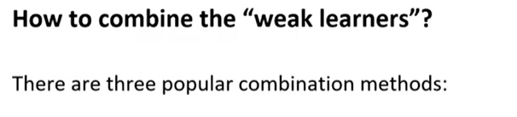
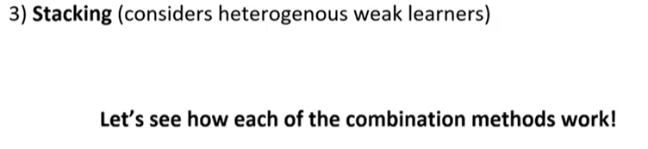

Slide 10
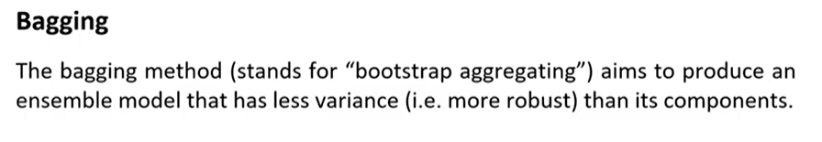
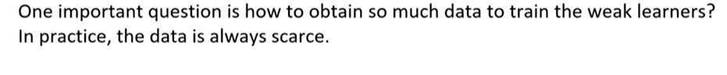
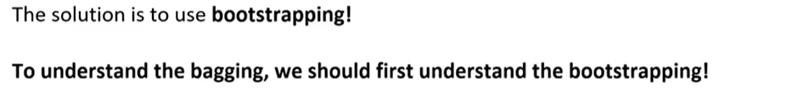

Slide 11
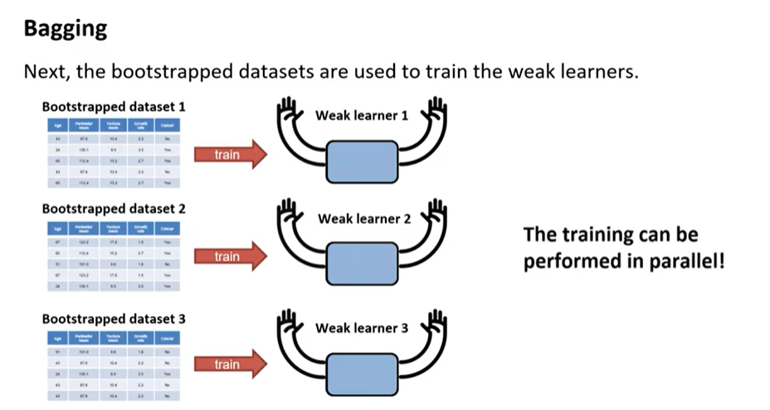

Slide 12
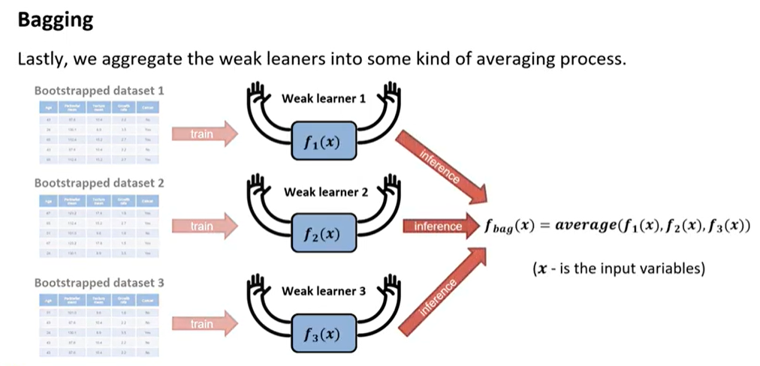

Slide 13
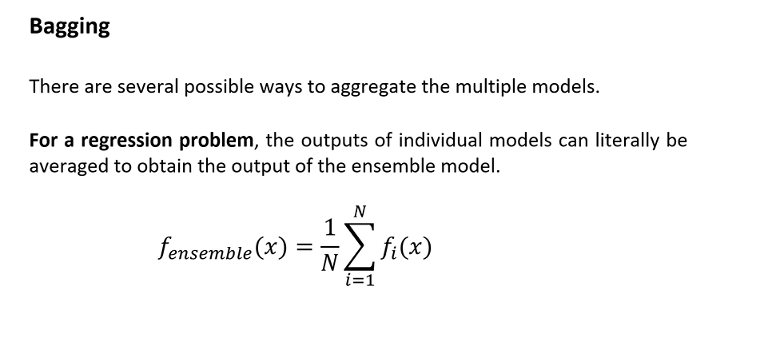

Slide 14
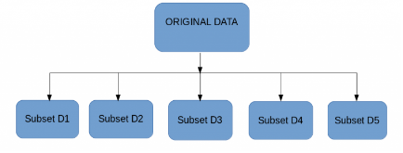
Bagging
Multiple subsets are created from the original dataset, selecting observations with replacement.
A base model (weak model) is created on each of these subsets.
The models run in parallel and are independent of each other.
The final predictions are determined by combining the predictions from all the models.

Slide 15
Random Forest

Slide 16
Random Forest
Ensemble method specifically designed for decision tree classifiers
Random Forests grows many trees
Ensemble of unpruned decision trees
Each base classifier classifies a “new” vector of attributes from the original data
Final result on classifying a new instance: voting. Forest chooses the classification result having the most votes (over all the trees in the forest)

Slide 17
Random Forest
Introduce two sources of randomness: “Bagging” and “Random input vectors”
Bagging method: each tree is grown using a bootstrap sample of training data
Random vector method: At each node, best split is chosen from a random sample of m attributes instead of all attributes

Slide 18
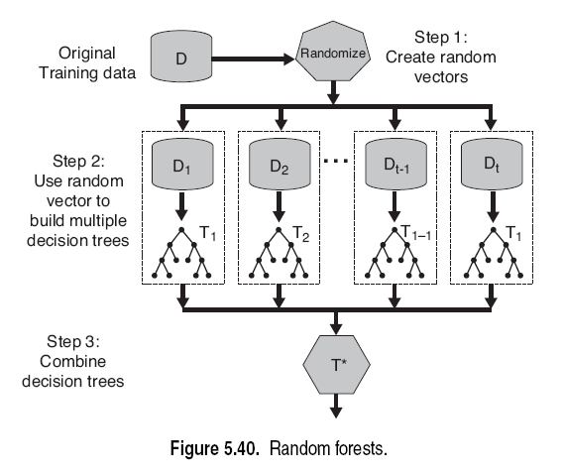
Random Forest

Slide 19
Random Forest Classifier
It is an ensemble tree-based learning algorithm
The Random Forest Classifier is a set of decision trees from randomly selected subset of training set.
It aggregates the votes from different decision trees to decide the final class of the test object.

Slide 20
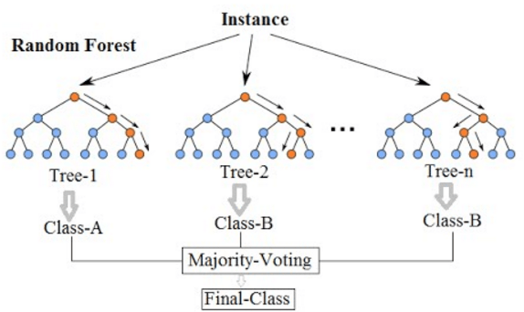

Slide 21
Types of Random Forest models:
Random Forest Prediction for a classification problem:
f(x) = majority vote of all predicted classes over B trees
Random Forest Prediction for a regression problem:
f(x) = sum of all sub-tree predictions divided over B trees

Slide 22
Features and Advantages of Random Forest :
It is one of the most accurate learning algorithms available. For many data sets, it produces a highly accurate classifier.
It runs efficiently on large databases.
It can handle thousands of input variables without variable deletion.
It gives estimates of what variables that are important in the classification.
It generates an internal unbiased estimate of the generalization error as the forest building progresses.
It has an effective method for estimating missing data and maintains accuracy when a large proportion of the data are missing.

Slide 23
Disadvantages of Random Forest :
Random forests have been observed to overfit for some datasets with noisy classification/regression tasks.
For data including categorical variables with different number of levels, random forests are biased in favor of those attributes with more levels. Therefore, the variable importance scores from random forest are not reliable for this type of data.

Slide 24
Random Forest Classifier :
Random forest, like its name implies, consists of a large number of individual decision trees that operate as an ensemble.
Each individual tree in the random forest spits out a class prediction and the class with the most votes becomes our model’s prediction (see figure below).
The fundamental concept behind random forest is a simple but powerful one — the wisdom of crowds. In data science speak, the reason that the random forest model works so well is:

Slide 25
Ensuring that the Models Diversify Each Other
So how does random forest ensure that the behavior of each individual tree is not too correlated with the behavior of any of the other trees in the model? It uses the following two methods:
Bagging (Bootstrap Aggregation) — Decisions trees are very sensitive to the data they are trained on — small changes to the training set can result in significantly different tree structures.
Random forest takes advantage of this by allowing each individual tree to randomly sample from the dataset with replacement, resulting in different trees. This process is known as bagging.

Slide 26
Adaboost Algorithm
Initialize weights
for t = 1:T
1. Set
2. Call weak learner WL_{t} with each x, and get back result vector
3. Find error ε_{t} of :
4. Set
5. Re-weight the training data
Output answer:
Normalizes so p weights sum to 1
Average error on training set weighted by p
Low overall error → β close to 0; (big impact on next step)
error almost 0.5 → β almost 1 (small impact “ “ “ )
Weighting the ones it got right less so next time it will focus more on the incorrect ones
Q3-5
Notes:
Step 2: was p^t, not x…

Slide 27
Characteristics
Advantages
Algorithm can solve both classification and regression problems
Can handle large data set with higher dimensionality.
It can handle thousands of input variables and identify most significant variables
dimensionality reduction
Model outputs Importance of variable, which can be a very handy feature (on some random data set).
Disadvantages
May over-fit datasets that are particularly noisy.
When the number of variables is large, but the fraction of relevant variables is small, random forests are likely to perform poorly when m is small
At each split the chance can be small that the relevant variables will be selected
For example, with 3 relevant and 100 not so relevant variables the probability of any of the relevant variables being selected at any split is ~0.25
Random Forest can feel like a black box approach for statistical modelers
you have very little control on what the model does.
You can at best try different parameters and random seeds!

Slide 28
Boosting

Slide 29
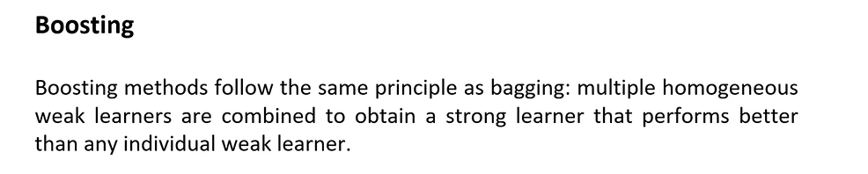
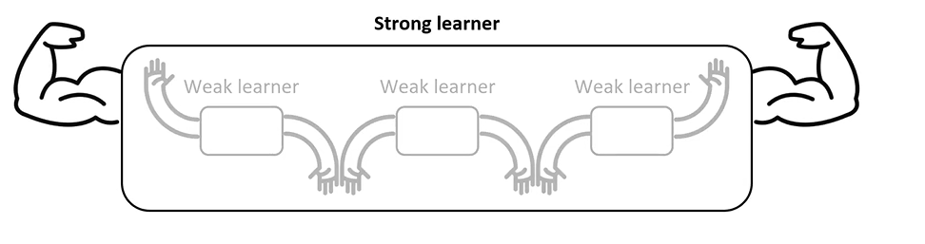
Boosting

Slide 30
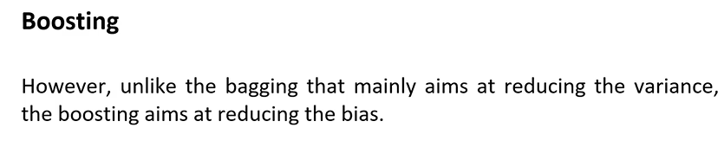
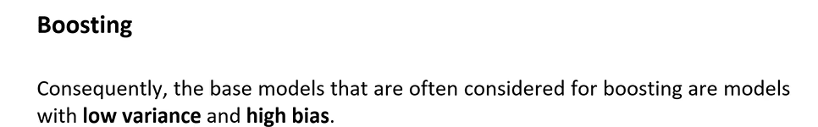
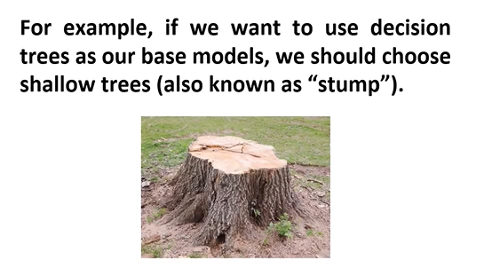
Boosting

Slide 31
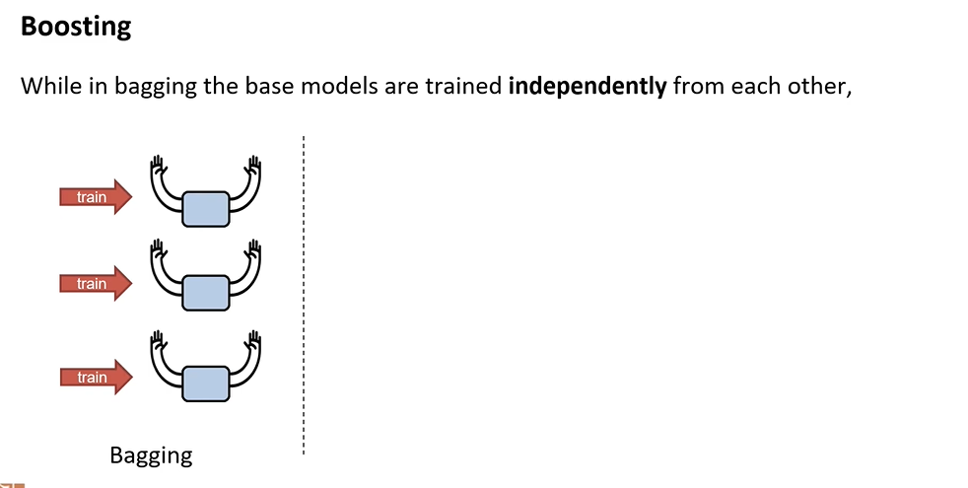
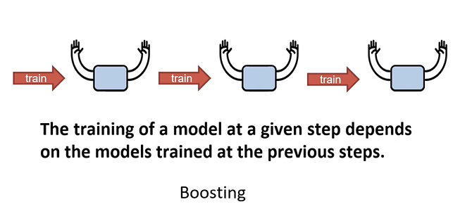
Boosting
Boosting

Slide 32
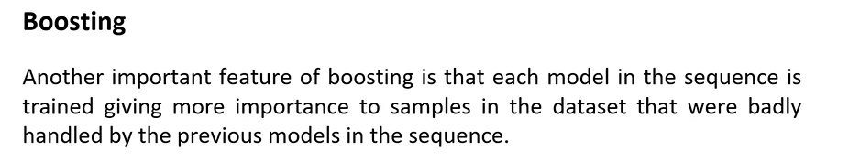
Boosting

Slide 33
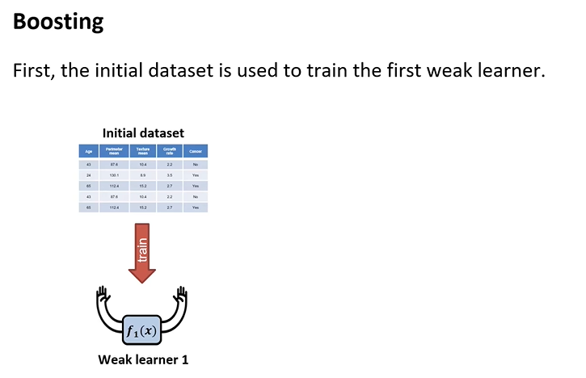
Boosting

Slide 34
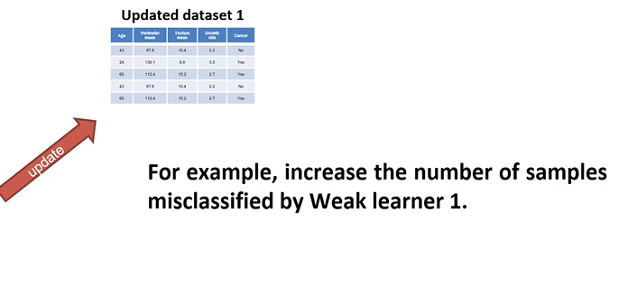
Boosting

Slide 35
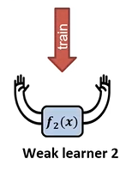
Boosting

Slide 36
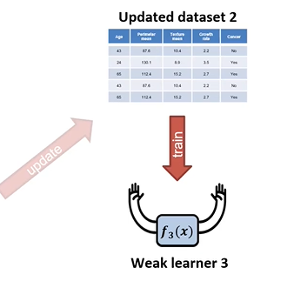
Boosting

Slide 37
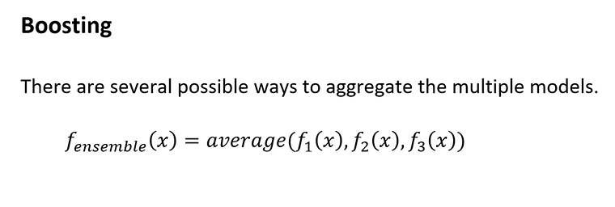
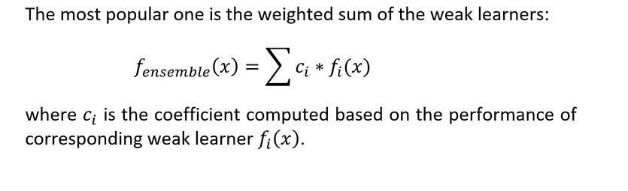
Boosting

Slide 38
AdaAdaBoost Algorithm

Slide 39
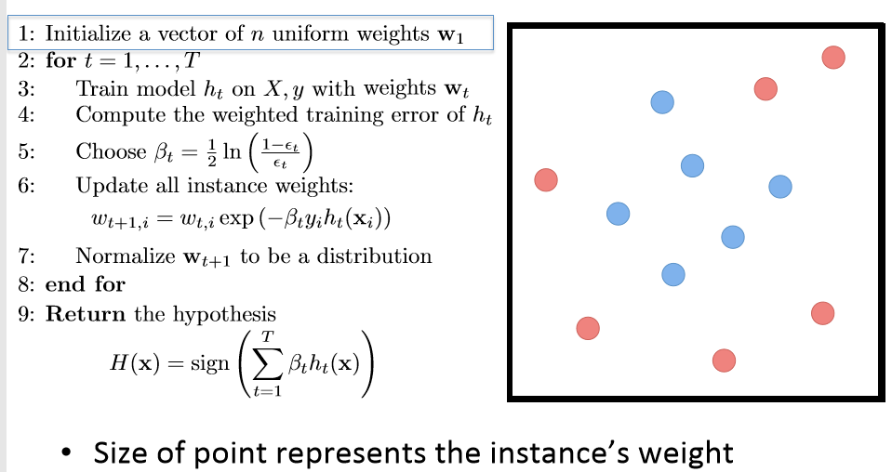
AdaBoost Algorithm
$$α in earlier slide same as β=weight of class$$

Slide 40
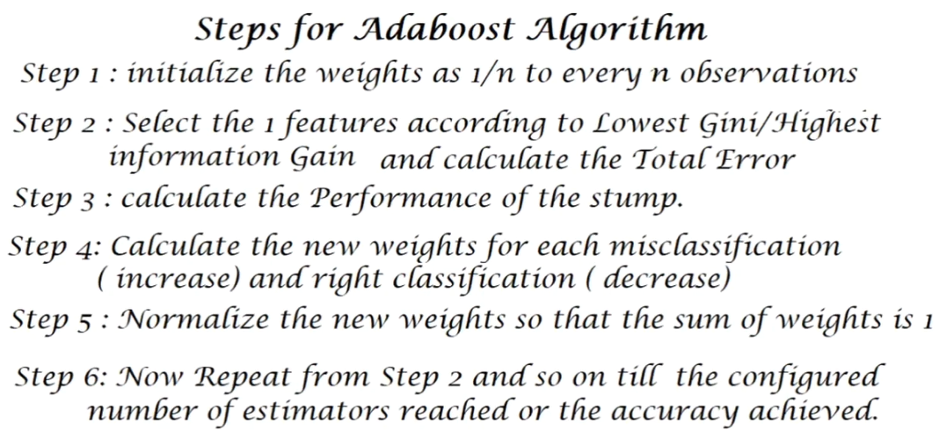
AdaBoost Algorithm

Slide 41
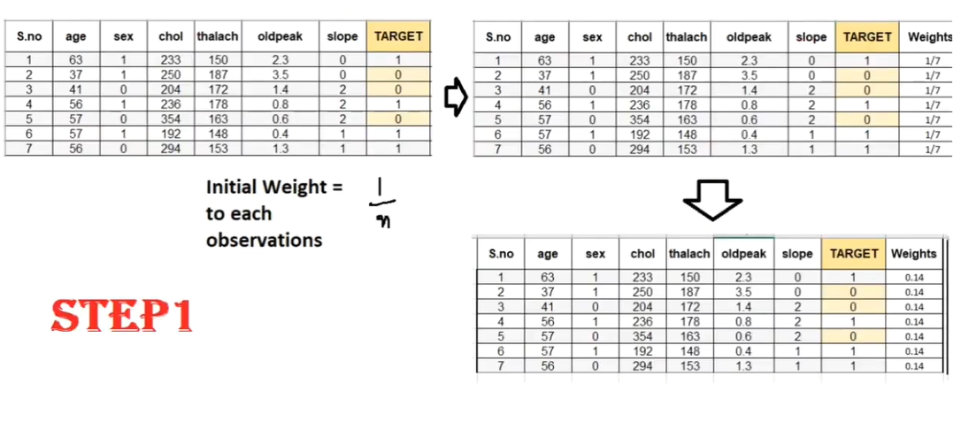
AdaBoost Algorithm - Example

Slide 42
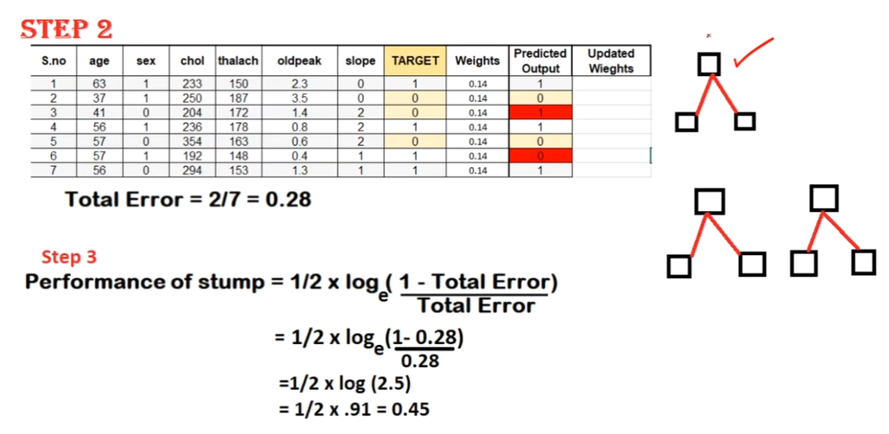
AdaBoost - Example

Slide 43
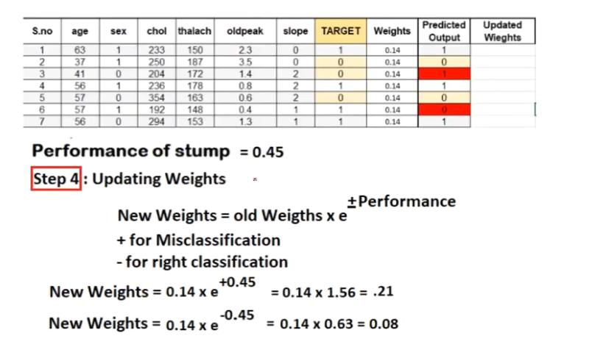
AdaBoost - Example

Slide 44
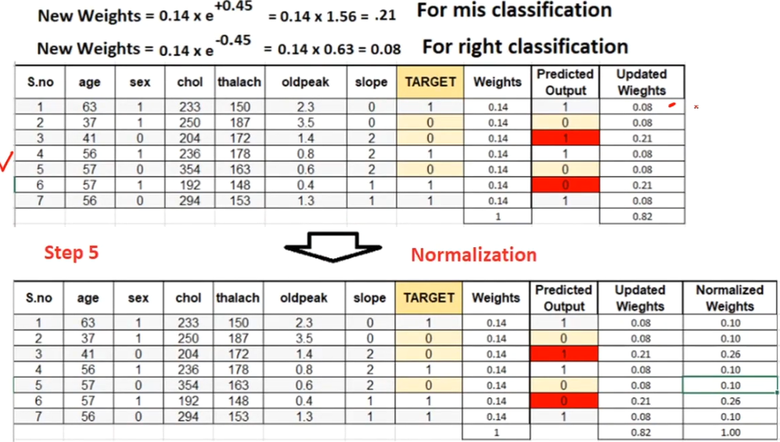
AdaBoost - Example

Slide 45
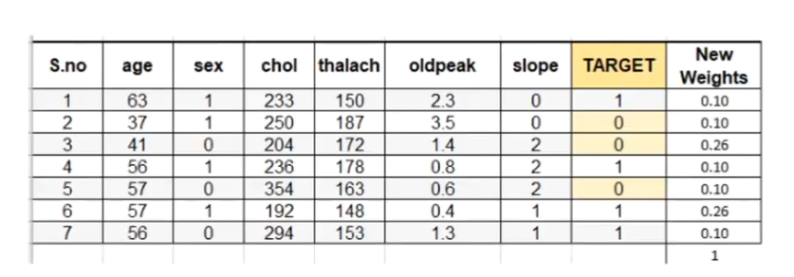
AdaBoost Alg_Example

Slide 46
Unsupervised Learning

Slide 47
Unsupervised Learning
We only use the features X, not the labels Y
This is useful because we may not have any labels, but we can still detect patterns
For example:
We can detect that news articles revolve around certain topics, and group them accordingly
Discover a distinct set of objects appear in a given environment, even if we don’t know their names, then ask humans to label each group
Identify health factors that correlate with a disease

Slide 48
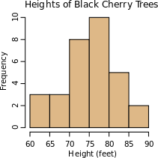
Why do we cluster?
Counting
Feature histograms: by grouping similar features and counting how many of each a data sample has
Summarizing data
Look at large amounts of data
Represent a large continuous vector with the cluster number
Prediction
Data points in the same cluster may have the same labels
Ask a human to label the clusters
Sl

Slide 49
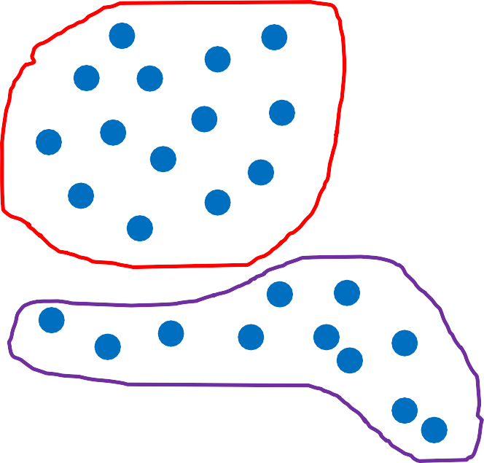



Two uses of clustering in one application
Cluster, then ask human to label groups
Compute a histogram to summarize the data
1
“cat”
2
“panda”
Count in this sample
3
“giraffe”
Feature cluster
3d feature
2d feature

Slide 50
Clustering algorithms
In depth
K-means (iterate between finding centers and assigning points)
Gaussian Mixture Models (GMMs)

Slide 51
K-means Algorithm
Goal: represent a data set in terms of K clusters each of which is summarized by a prototype
Initialize prototypes, then iterate between two phases:
E-step: assign each data point to nearest prototype
M-step: update prototypes to be the cluster means
Simplest version is based on Euclidean distance re-scale Old Faithful data

Slide 52
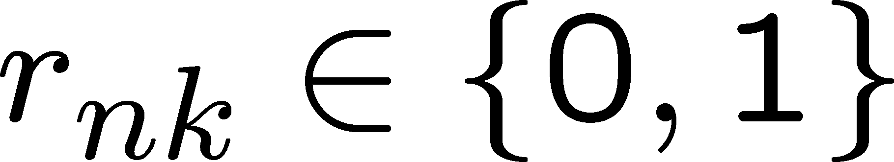
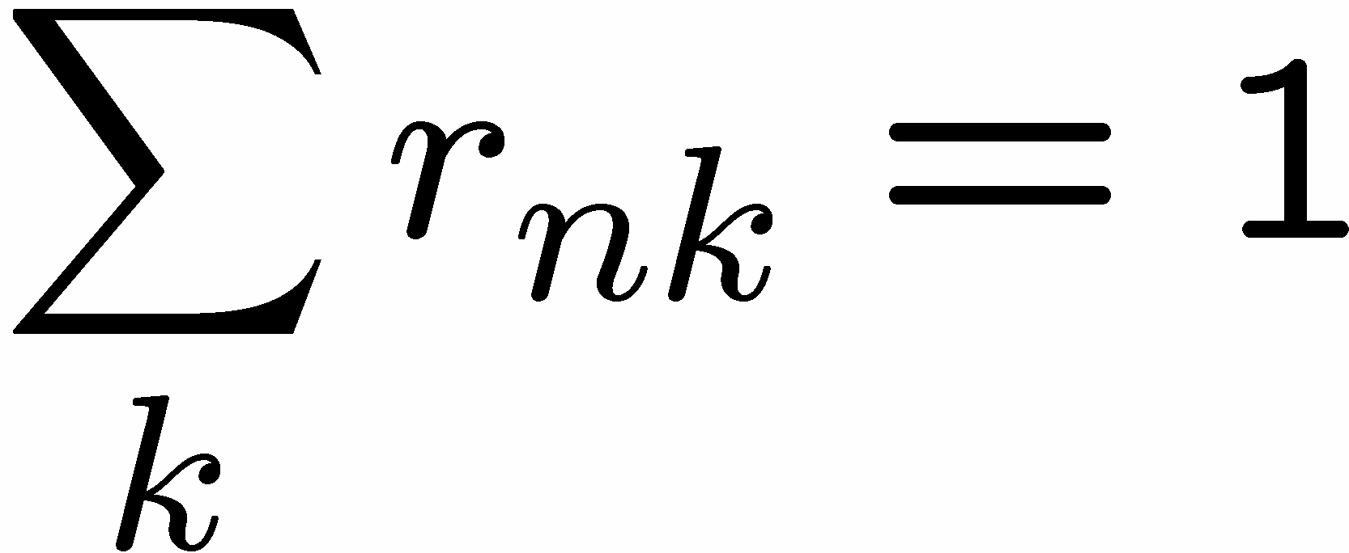
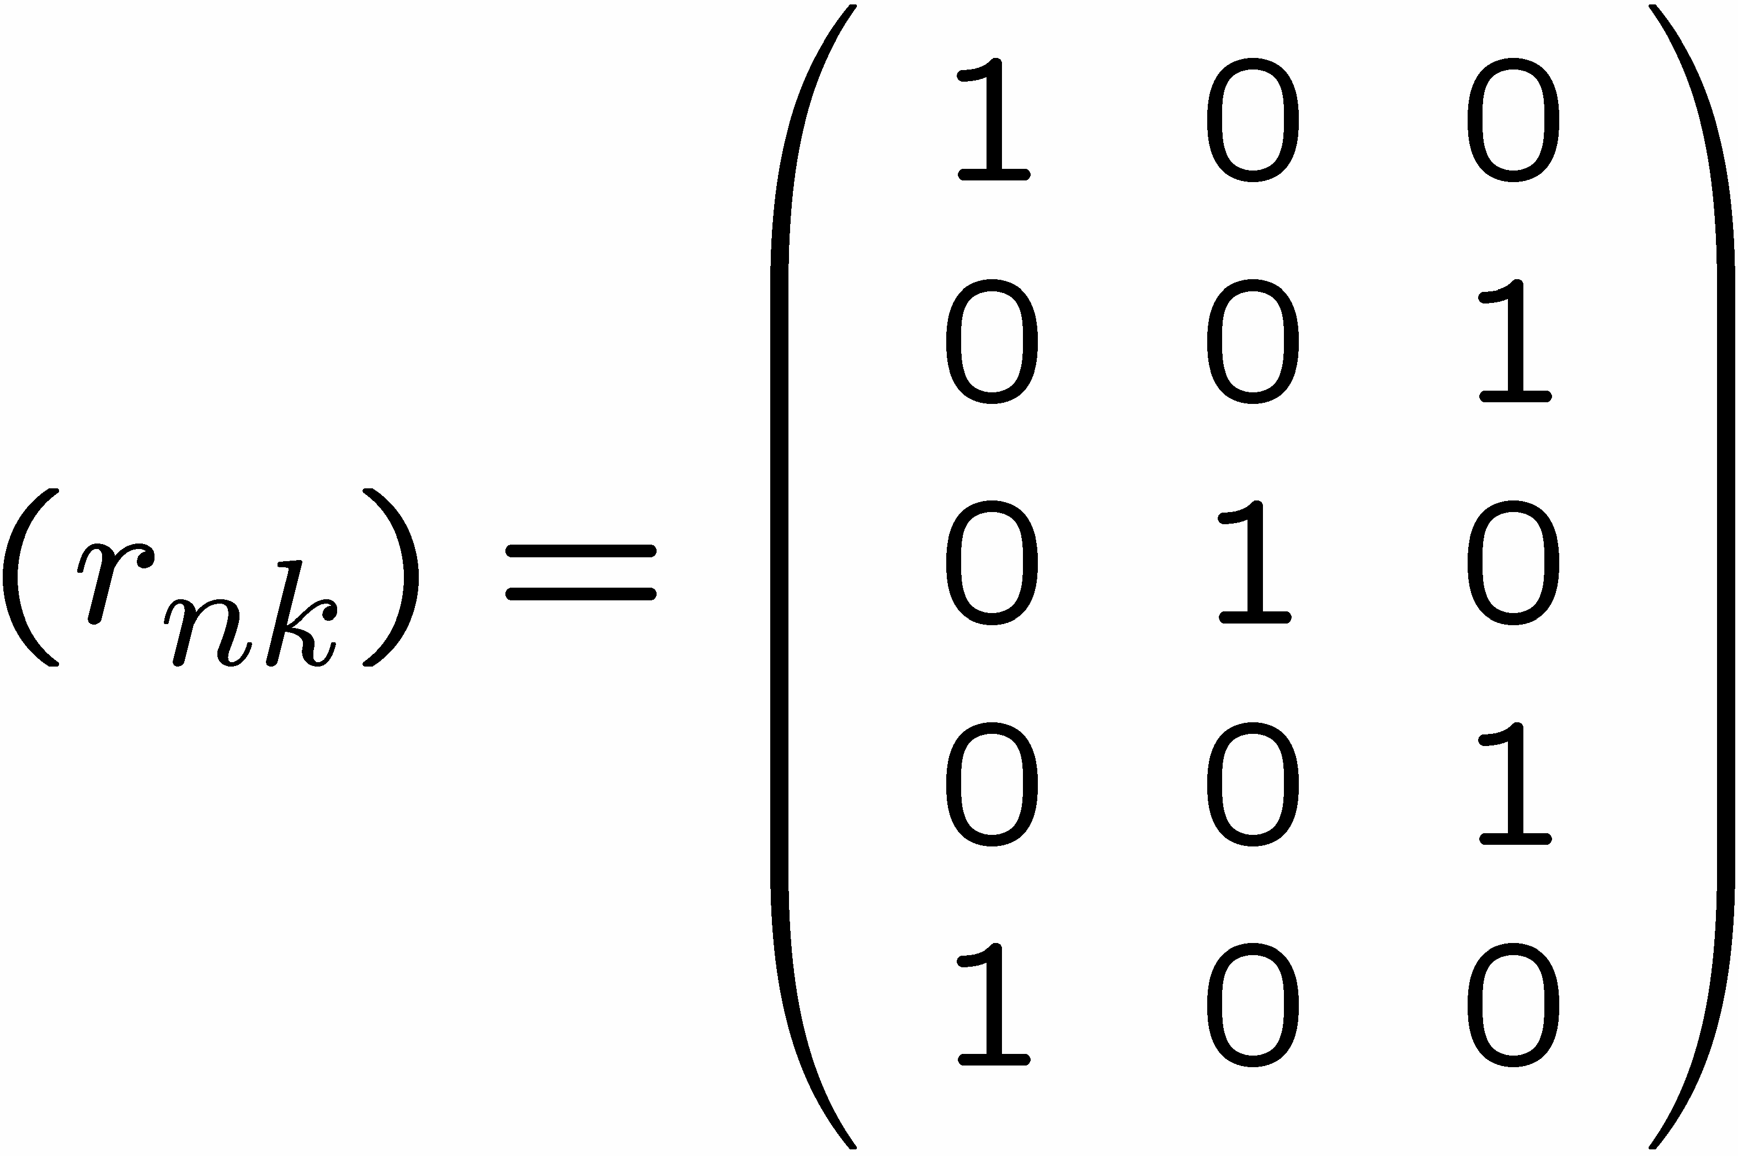
1 of K coding mechanism
For each data point x_{n}, we introduce a set of binary indicator variables
such that
where k =1,...,K describing which of the K clusters the data point x_{n} is assigned to, so that if data point x_{n} is assigned to cluster k then r_{nk} =1, and r_{nj} =0 for j not equal to k.
Example: 5 data points and 3 clusters

Slide 53
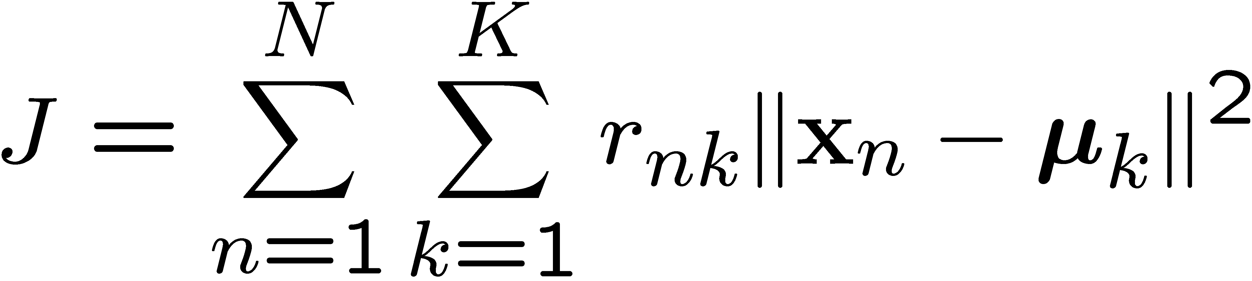
K-means Cost Function
data
responsibilities
prototypes

Slide 54
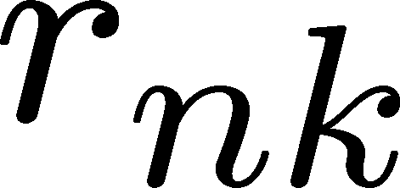










Minimizing the Cost Function
E-step: minimize J w.r.t.
M-step: minimize J w.r.t
Convergence guaranteed since there is a finite number of possible settings for the responsibilities

Slide 55
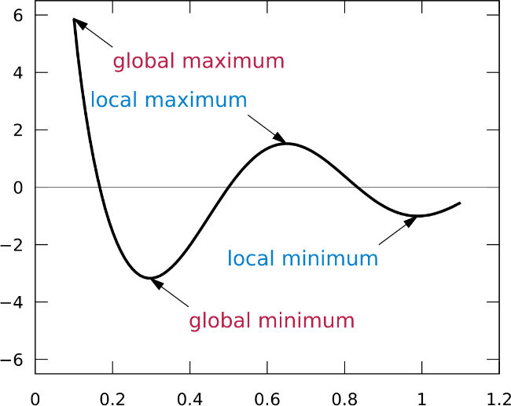
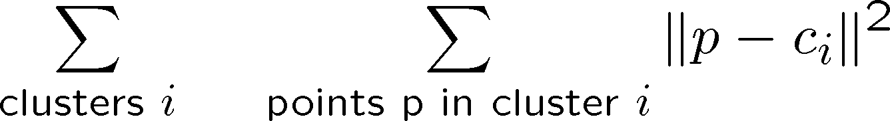
K-means clustering
Basic idea: randomly initialize the k cluster centers, and iterate between the two steps we just saw.
Randomly initialize the cluster centers, c₁, ..., c_{K}
Given cluster centers, determine points in each cluster
For each point p, find the closest c_{i}. Put p into cluster i
Given points in each cluster, solve for c_{i}
Set c_{i} to be the mean of points in cluster i
If c_{i} have changed, repeat Step 2
Properties
Will always converge to some solution
Can be a “local minimum” of objective:

Slide 56
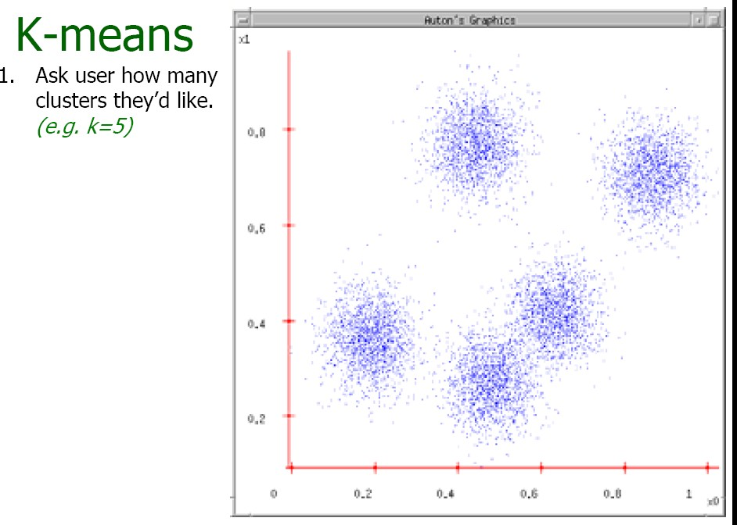
Source: A. Moore

Slide 57
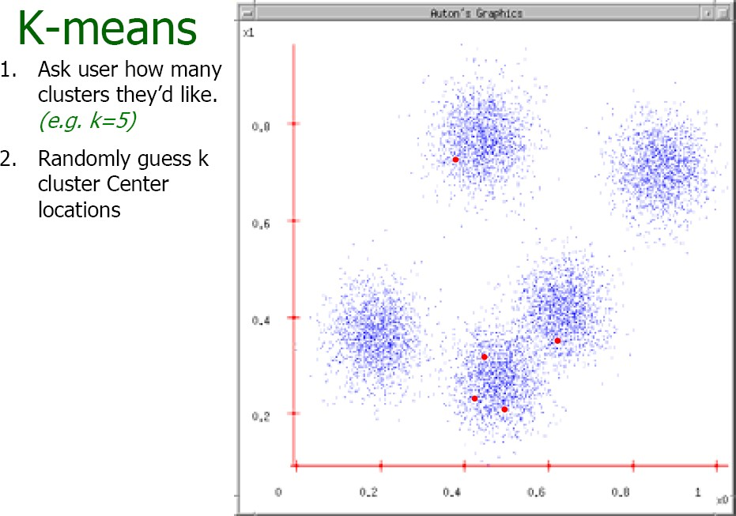

Slide 58
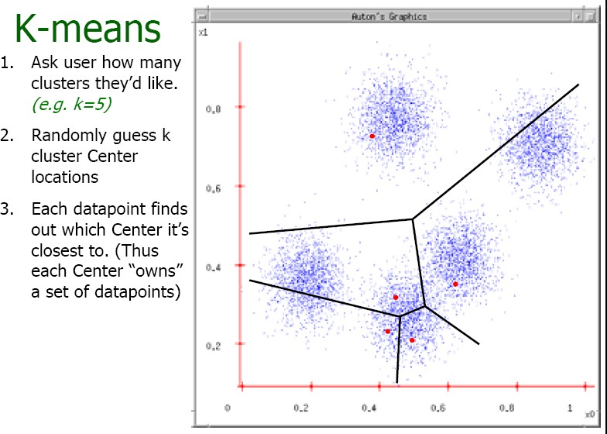

Slide 59
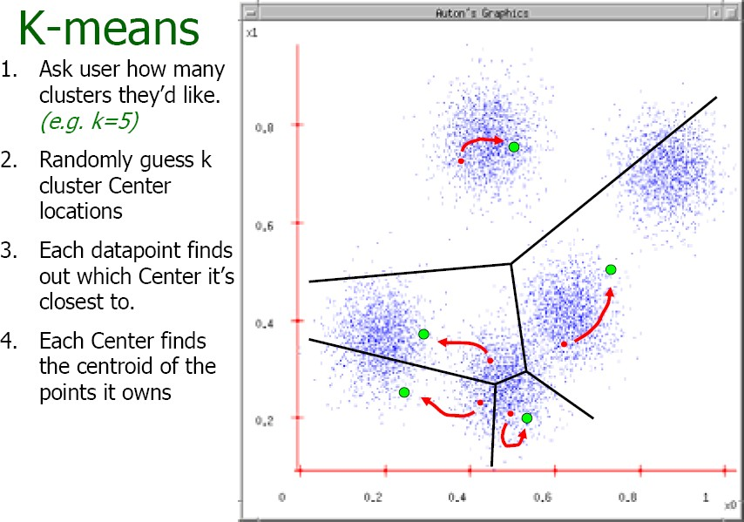

Slide 60
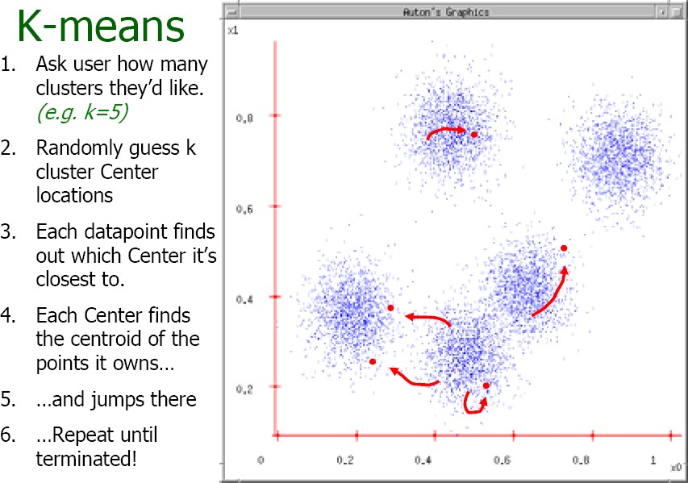

Slide 61
Time Complexity
Let n = number of instances, d = dimensionality of the features,
k = number of clusters
Assume computing distance between two instances is O(d)
Reassigning clusters:
O(kn) distance computations, or O(knd)
Computing centroids:
Each instance vector gets added once to a centroid: O(nd)
Assume these two steps are each done once for a fixed number of iterations I: O(Iknd)
Linear in all relevant factors

Slide 62
Probabilistic Clustering
Represent the probability distribution of the data as a mixture model
captures uncertainty in cluster assignments
gives model for data distribution
Bayesian mixture model allows us to determine K
Consider mixtures of Gaussians

Slide 63
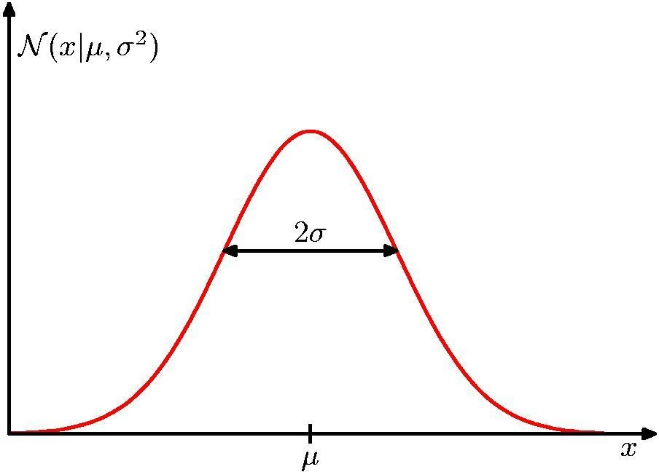
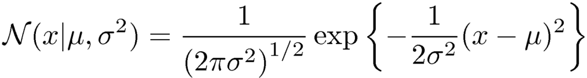
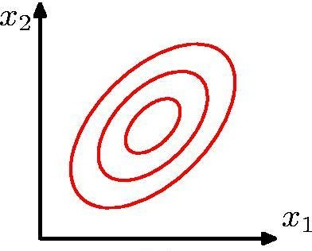
Review: Gaussian Distribution

Slide 64
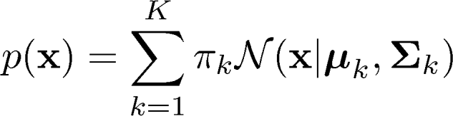


Mixtures of Gaussians
Combine simple models into a complex model:
Component Mixing coefficient
K=3
Find parameters through EM (Expectation Maximization) algorithm

Slide 65


Probabilistic version: Mixtures of Gaussians
Single Gaussian
Mixture of two
Gaussians

Slide 66
Thank You!

